Slide 1
Alternative Energies
Coastal Studies Institute

Slide 2
Outline
Electricity
Fraday's Law
Energy Sources
North Carolina Renewable Energy Program
Ocean Energy Devices

Slide 3
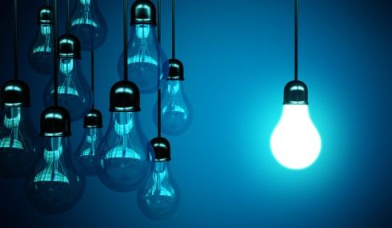
Electricity
Simply put, electricity is the flow of electric current along a conductor.
Electric current is the transfer of free electrons from one atom to the next.
There are three primary electrical parameters: volts, amps, and ohms

Slide 4
Electrical Parameters
VOLT: electrical pressure, like the water pressure in a pipe
AMPERE: how much electrical charge is flowing past a given point in one second, the flow rate of electric current
OHM: unit of electrical resistance in a conductor
WATTS: unit of electrical power
WATTS = VOLTS X AMPS

Slide 5
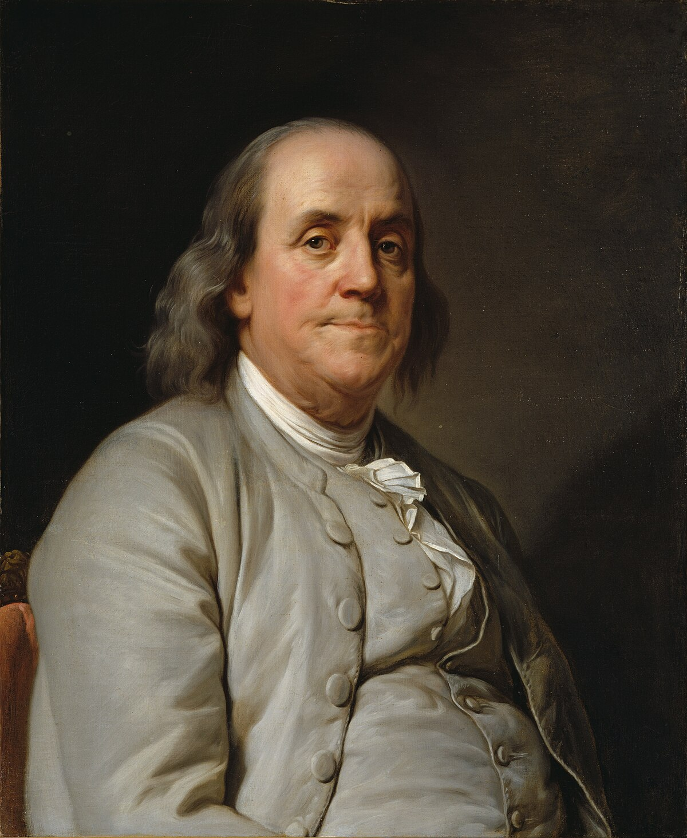
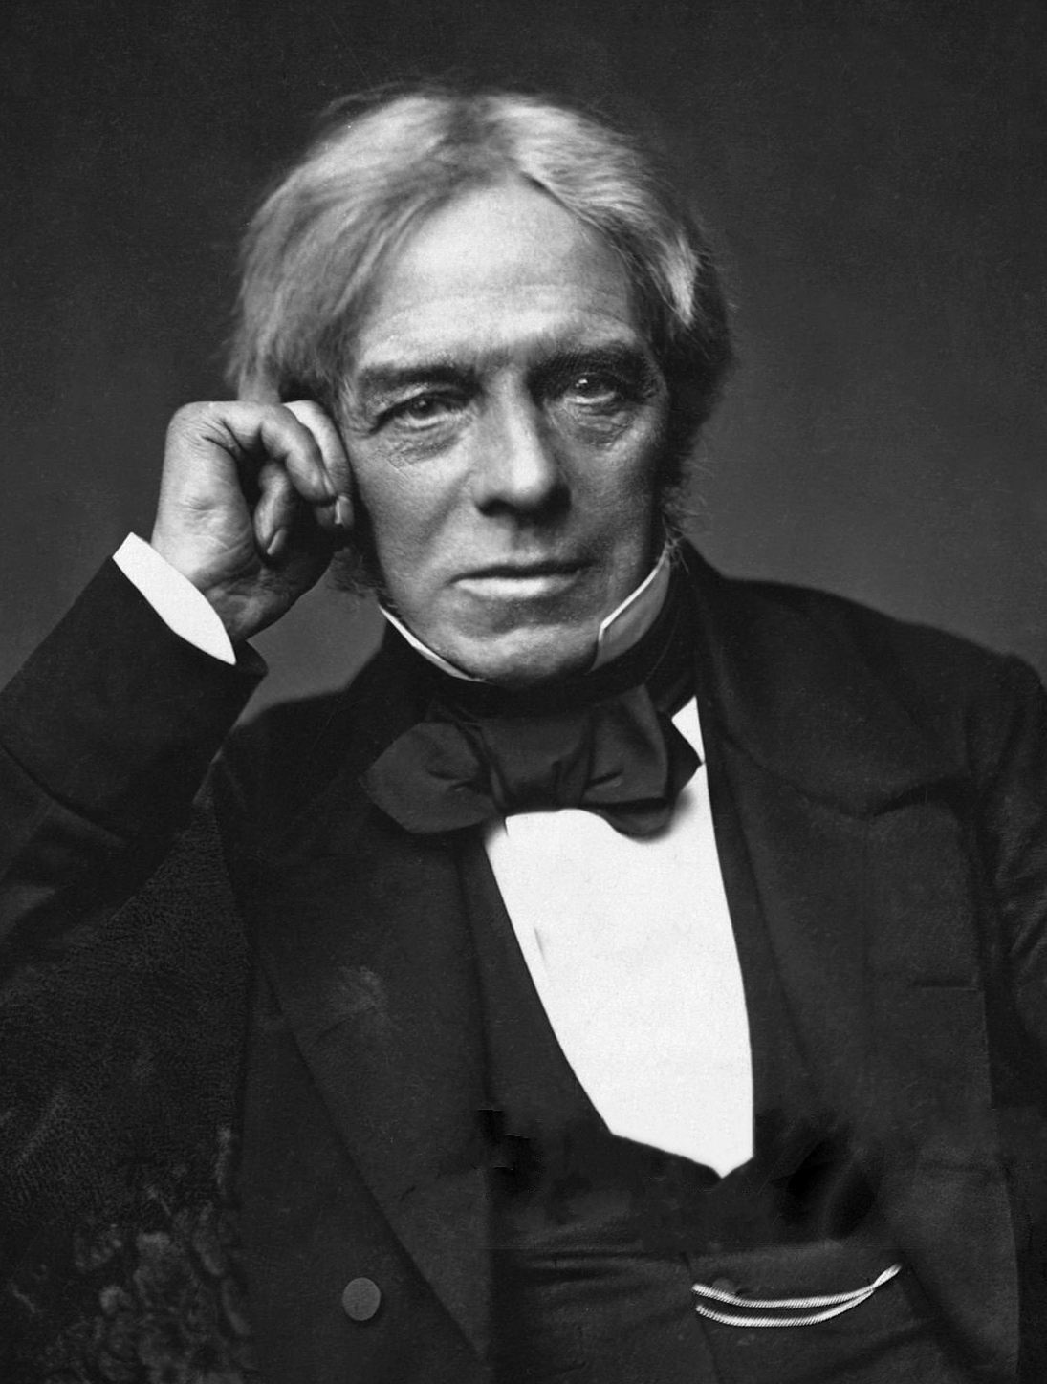
June 1752 – Ben Franklin flew a kite with metal key attached in a storm threatened sky.
Electricity History
1831 – Micheal Faraday invented the electric motor and discovered the phenomenon of electromagnetic induction.

Slide 6
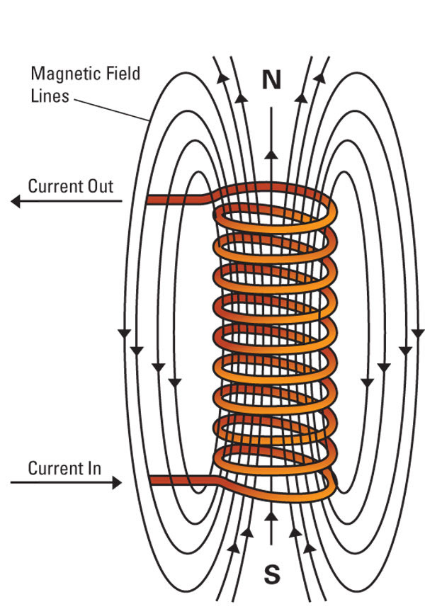
Faraday’s Law of Induction
Electromagnetism: electrically charged particles create a magnetic field
A changing magnetic field creates an electric field
Electromagnetic Induction: the production of an electromagnetic force across and electrical conductor in a changing magnetic field

Slide 7
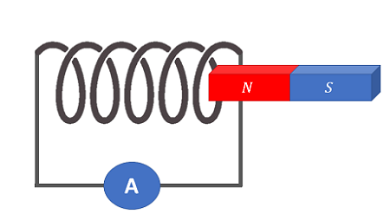
Electromagnetic Induction
Simply put, pass a magnet by a coil of copper, produce electrical energy
Coiled wire
Direction of movement
Induced voltage in wire

Slide 8
Electromagnetic Induction
Faraday invented the first electric motor
made of a coil of wire and a permanent magnet that was moved relative to the coil, which induced electric current
Direct Current vs. Alternating Current
DC: electrons flow steadily in one direction
AC: electrons flow back and forth

Slide 9
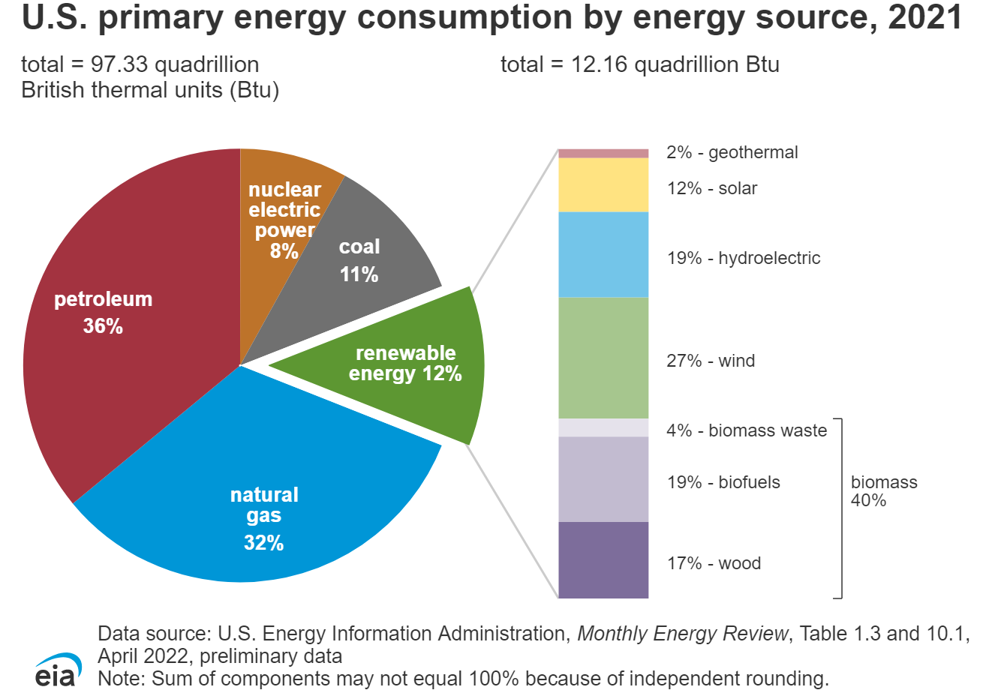
Where does our energy come from?

Slide 10
Fossil Fuels
Coal, petroleum, natural gas
Non-renewable sources
Burning produces heat – also releases greenhouse gases
Relatively inexpensive, easily transported
Not sustainable, contributes to global warming, extraction can be damaging to landscape, economic fluctuations

Slide 11
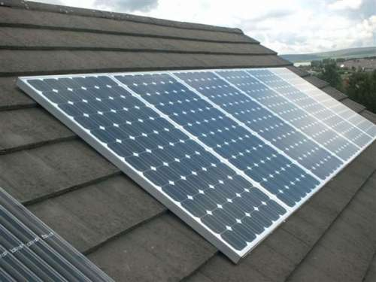
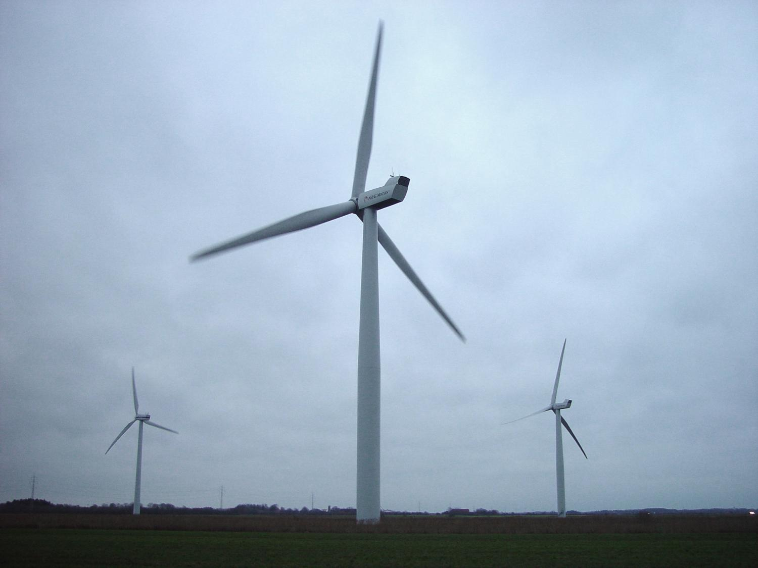
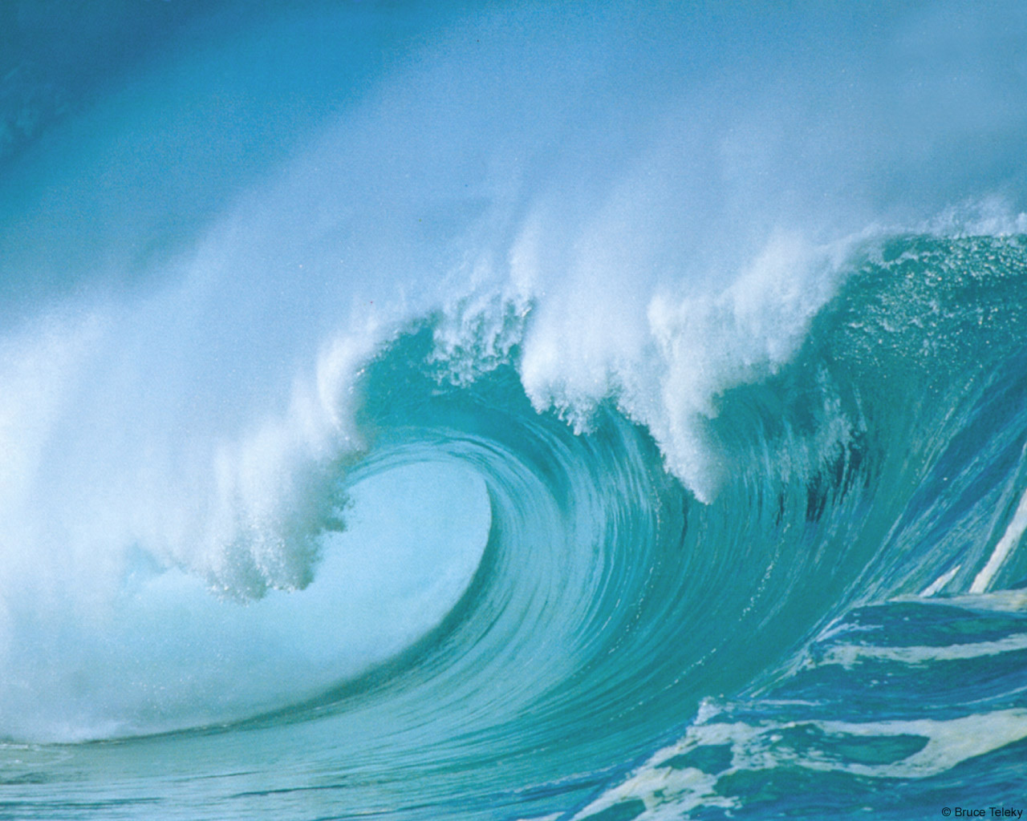
Alternative Energy
Solar Power – heat and light from the sun
Wind Power – kinetic energy to electricity
Hydroelectric – using flowing water (rivers, dams)
Ocean Energy – kinetic energy to electricity by harnessing waves, currents, and tides

Slide 12
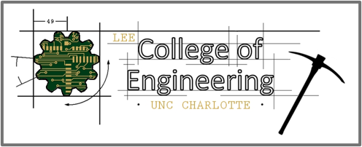
North Carolina Renewable Ocean Energy Program
Based at CSI and in partnership with the colleges of engineering at NCSU, UNCC, and NC A&T
A state-funded program that seeks to develop and advance sustainable marine energy solutions to power North Carolina’s Blue Economy

Slide 14
Ocean Energy Devices

Slide 15
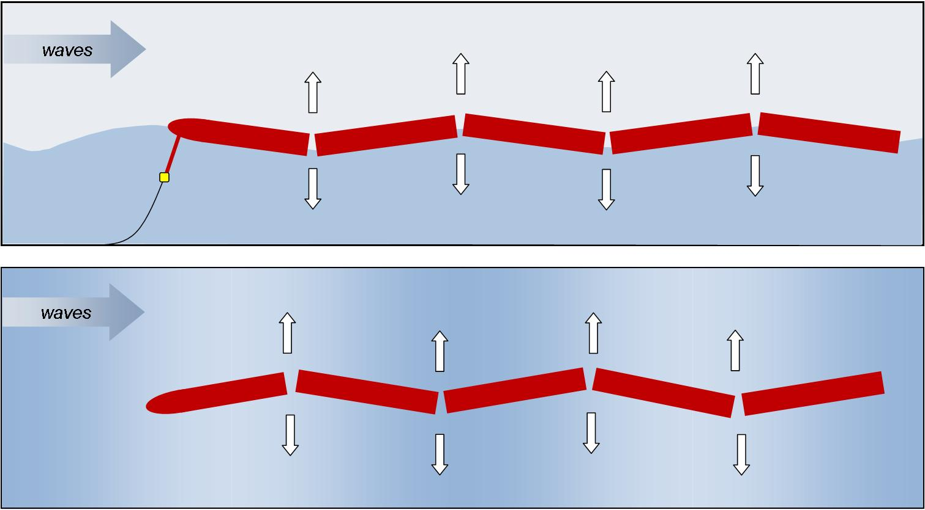
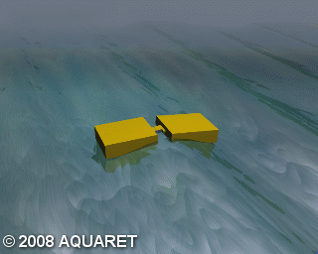
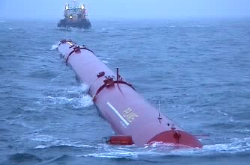
Attenuator - Waves
Large jointed sections that move parallel to the wave direction on the waters’ surface
Rise and fall of waves create a flexing motion – converted into rotation or hydraulic pumps to generate electricity
Offshore, >50 m depth
Pelamis

Slide 16
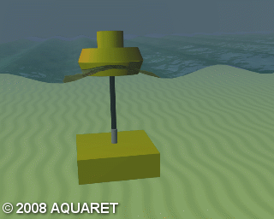
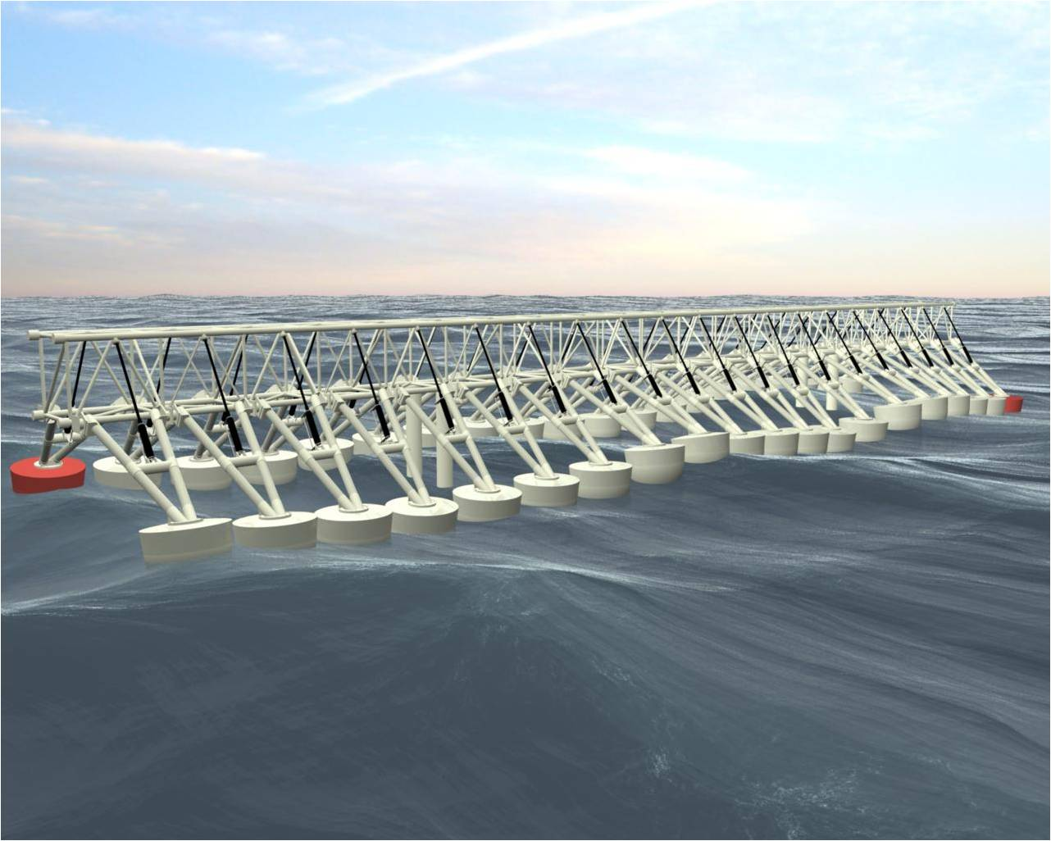
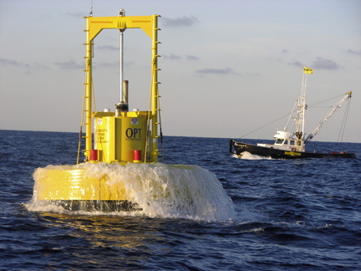
Point Absorber - Waves
Buoy-like device(s) sit on the waters’ surface and move relative to a stationary structure in response to wave action
Electricity produced by a generator or pumped fluid
Useable in many water depths
Wave Star
(multi-point absorber)
OPT’s PowerBuoy
(single point absorber)

Slide 17
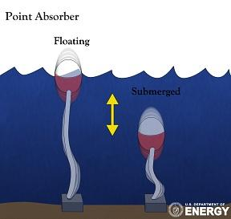
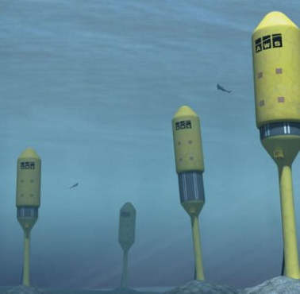
Submerged Point Absorber
Submerged buoy device moves relative to a stationary seabed foundation in response to deeper orbital motion of wave energy
Electricity produced by a generator or pumped fluid
80-90 m depths
Archimedes Wave Swing

Slide 18
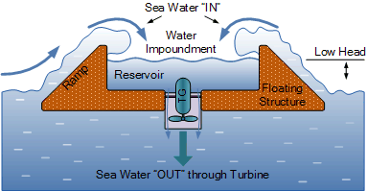
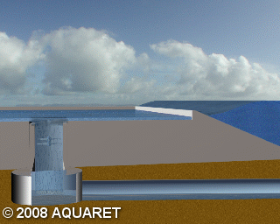
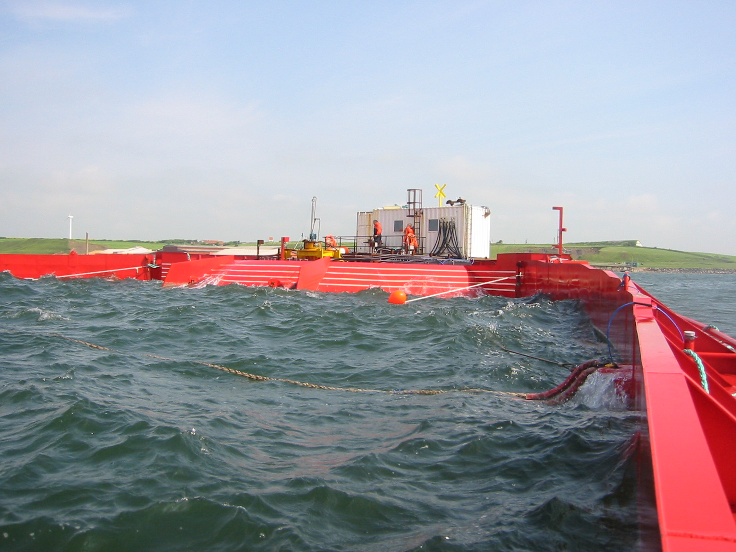
Overtopping Terminator – Waves
Wave action fills a reservoir to a higher level than the surrounding ocean
Pressure difference forces fluid through turbine to spin a generator and produce electricity
Nearshore, 6-30 m depths
Wave Dragon

Slide 19
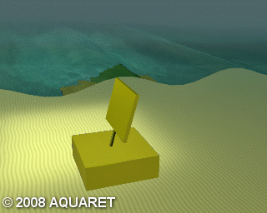
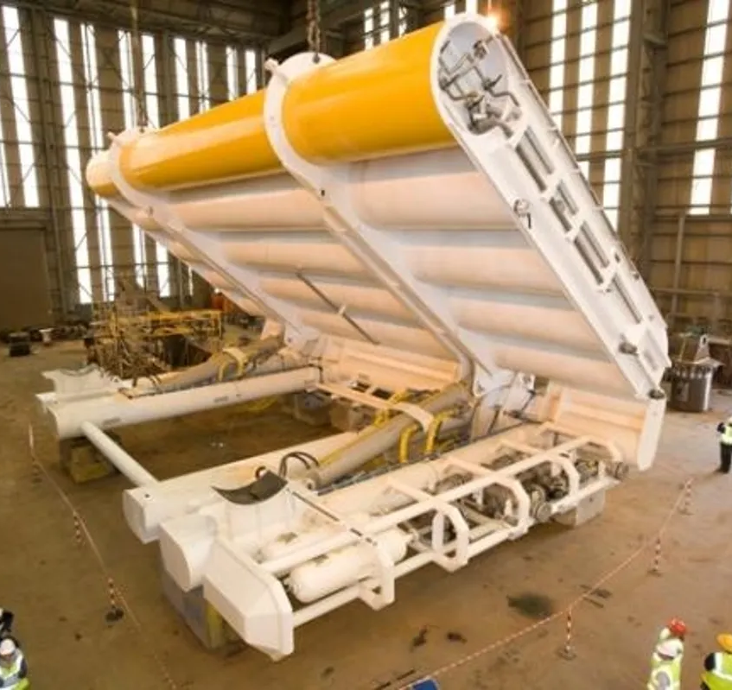
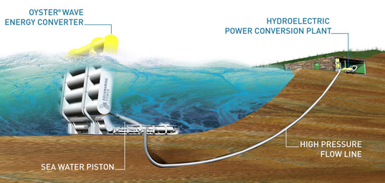
Surge Converter - Waves
Flapping panel that is moved by the horizontal motion of waves relative to the fixed foundation
This movement can be used to run a generator or pressurize fluid to produce electricity
Nearshore, 10-15 m depths

Slide 20
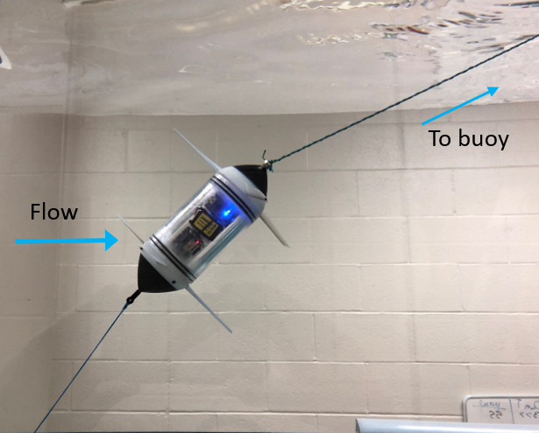
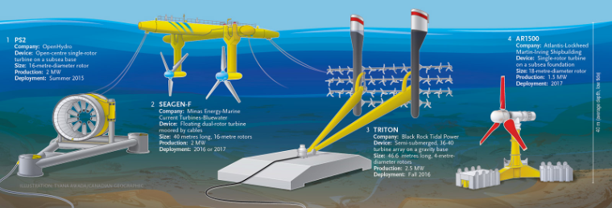
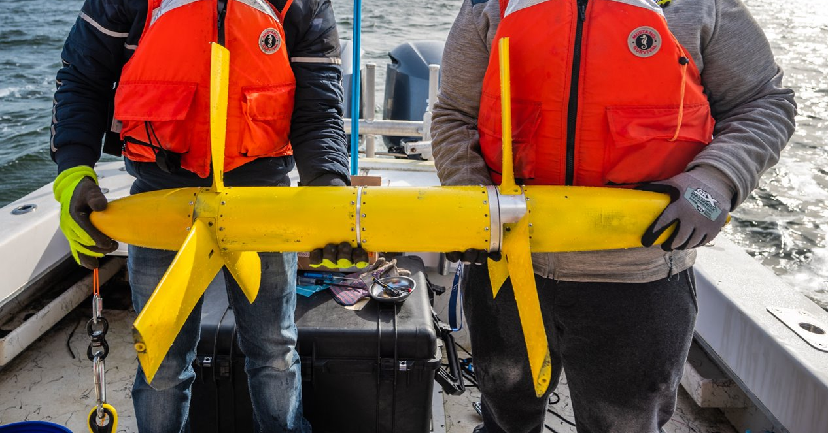
Turbines - Currents
Energy of moving water captured by spinning blades, parallel or perpendicular to the flow of water
Spinning blades run a generator to produce electricity
Operational anywhere in water column
Coaxial Turbine

Slide 21
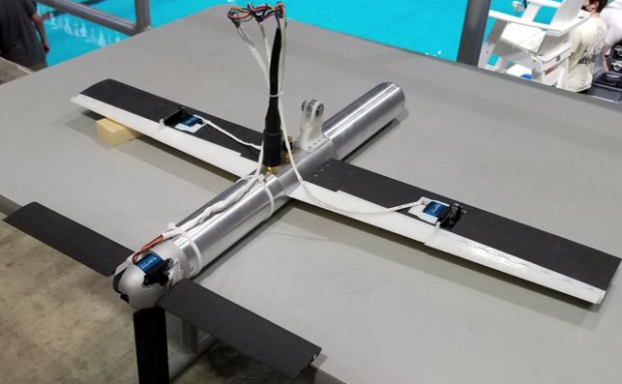
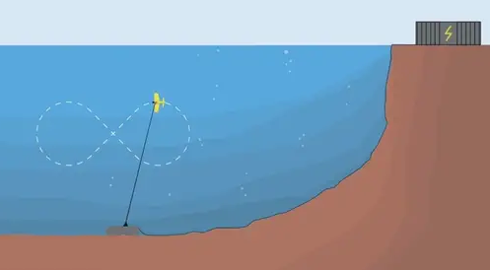
Kite - Currents
Device with hydrodynamic wing, tethered by a cable, that flies in programmed figure 8 shapes across currents
Electricity produced by on-board turbines or cycling spooling motion

